Slide 1
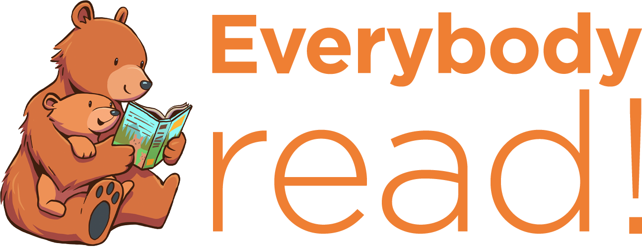
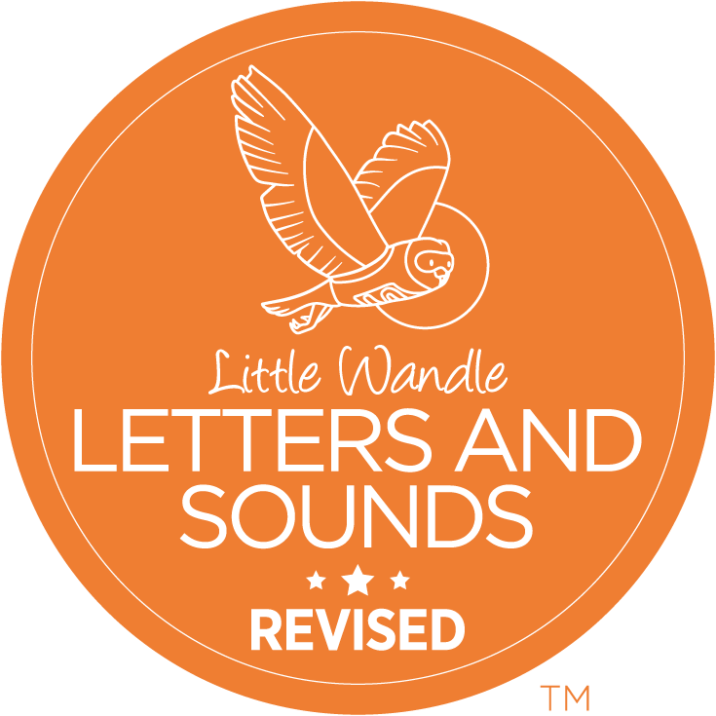
How we teach reading at Carlton Hill
Why reading to your child really matters

Slide 2

We are no longer a Bug Club phonics school

Slide 3
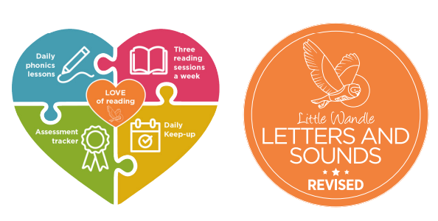
We now teach phonics and early reading with Little Wandle

Slide 4
Reception, Year 1 and Year 2
-2 x Little Wandle phonics lessons per day at a phase that matches the class
-Frequent low stakes assessments to check progress and ensure children are learning at the correct level for them
-3 x guided reading sessions per week with a school adult, reading books matched to each individual child’s level

Slide 5
Supporting your child with reading
Although your child will be taught to read at school, you can have a huge impact on their reading journey by continuing their practice at home.
There are two types of reading book that your child may bring home:
1. A phonics book. This will be at the correct phonic stage for your child. They should be able to read this fluently and independently.
2. A sharing book. Your child will not be able to read this on their own. This book is for you both to read and enjoy together.

Slide 6
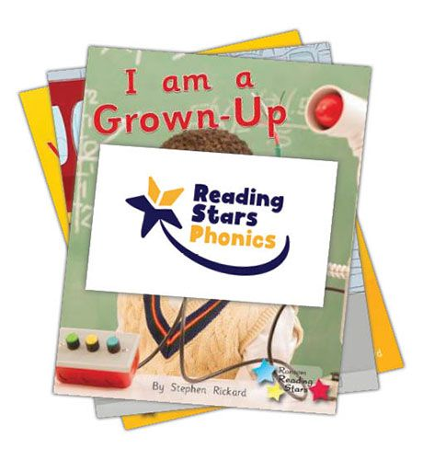
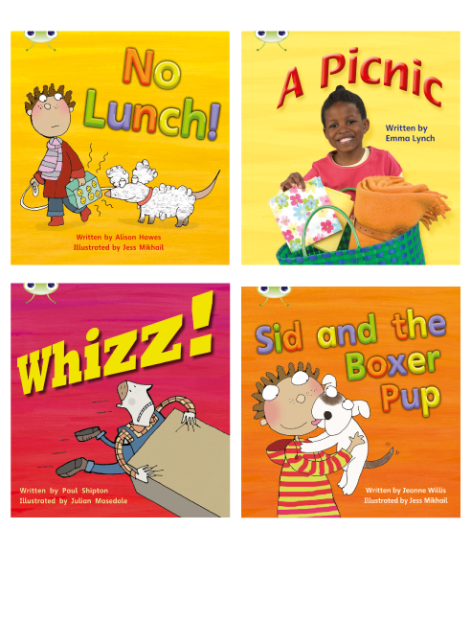
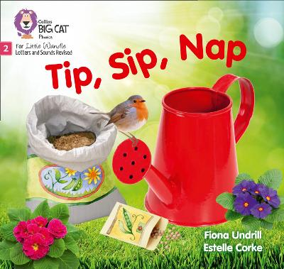
1. Phonics book
This book has been carefully matched to your child’s current reading level. If your child is reading it with little help, please don’t worry that it’s too easy – your child needs to develop fluency and confidence in reading.
Listen to them read the book. Remember to give them lots of praise – celebrate their success! If they can’t read a word, read it to them. After they have finished, talk about the book together.

Slide 7
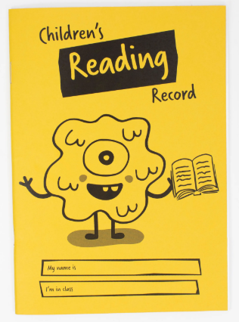
Your child will take a new phonics book home on a Friday.
Please try to listen to your child read you this book at least 3 x per week.
Date when you have read with your child in their yellow diary.
This diary should come to school with your child every day!
Please make sure book are returned by Friday. They are expensive!

Slide 8
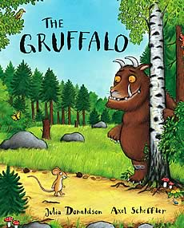
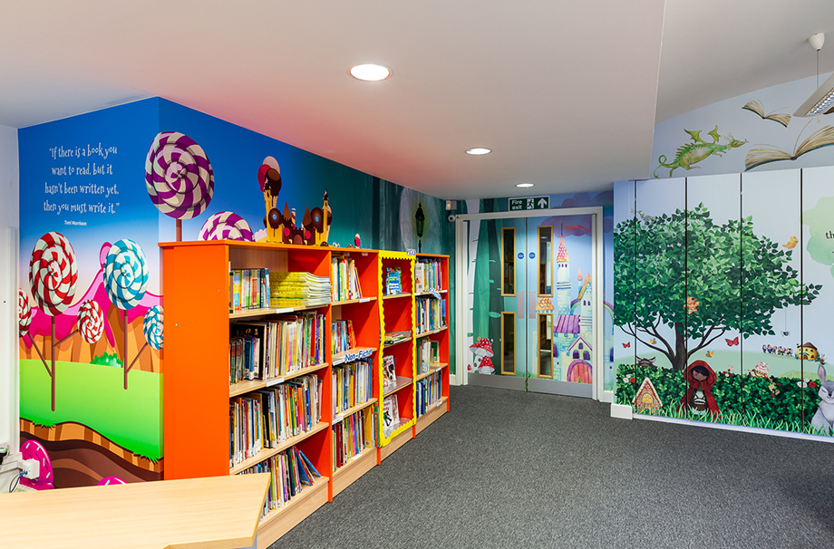
2. Sharing book
In order to encourage your child to become a lifelong reader, it is important that they learn to read for pleasure. The sharing book is a book they have chosen for you to enjoy together.
Please remember that you shouldn’t expect your child to read this alone. Read it to or with them. Discuss the pictures, enjoy the story, predict what might happen next, use different voices for the characters, explore the facts in a non-fiction book. The main thing is that you have fun!

Slide 9
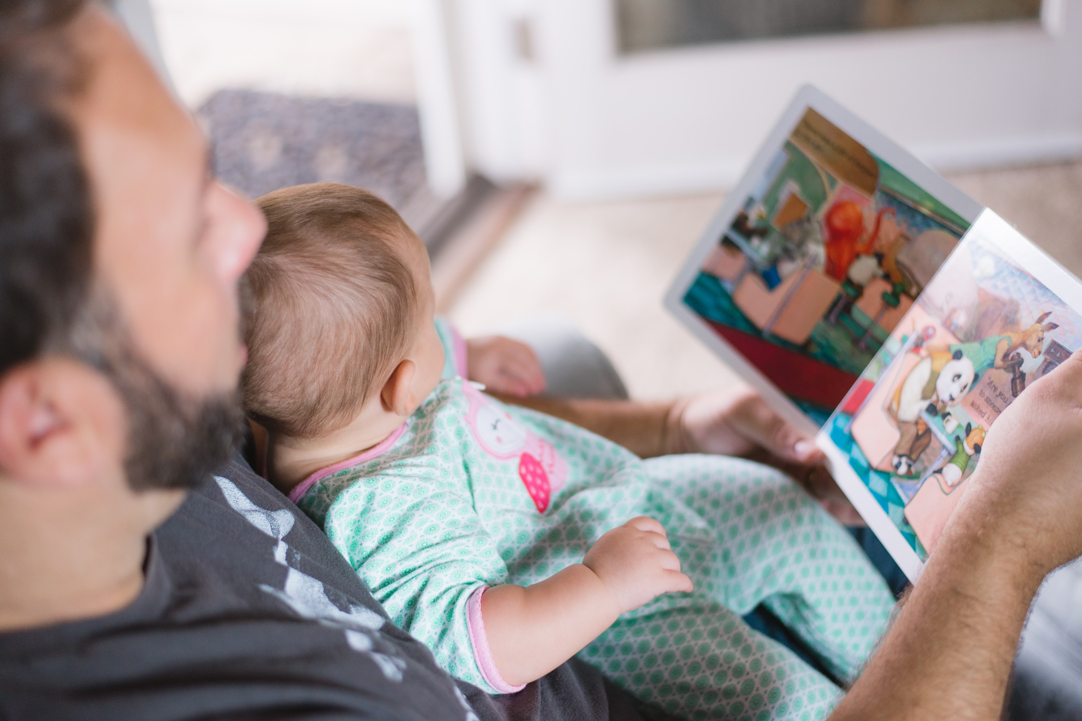
Why read with your child at home?
Reading a book and chatting about it has a positive impact on children’s ability to:
understand words and sentences
use a wide range of vocabulary
develop listening comprehension skills
Parental involvement in the development of children’s reading skills: A five-year longitudinal study (2002) Senechal, M. and Lefvre, J.

Slide 10
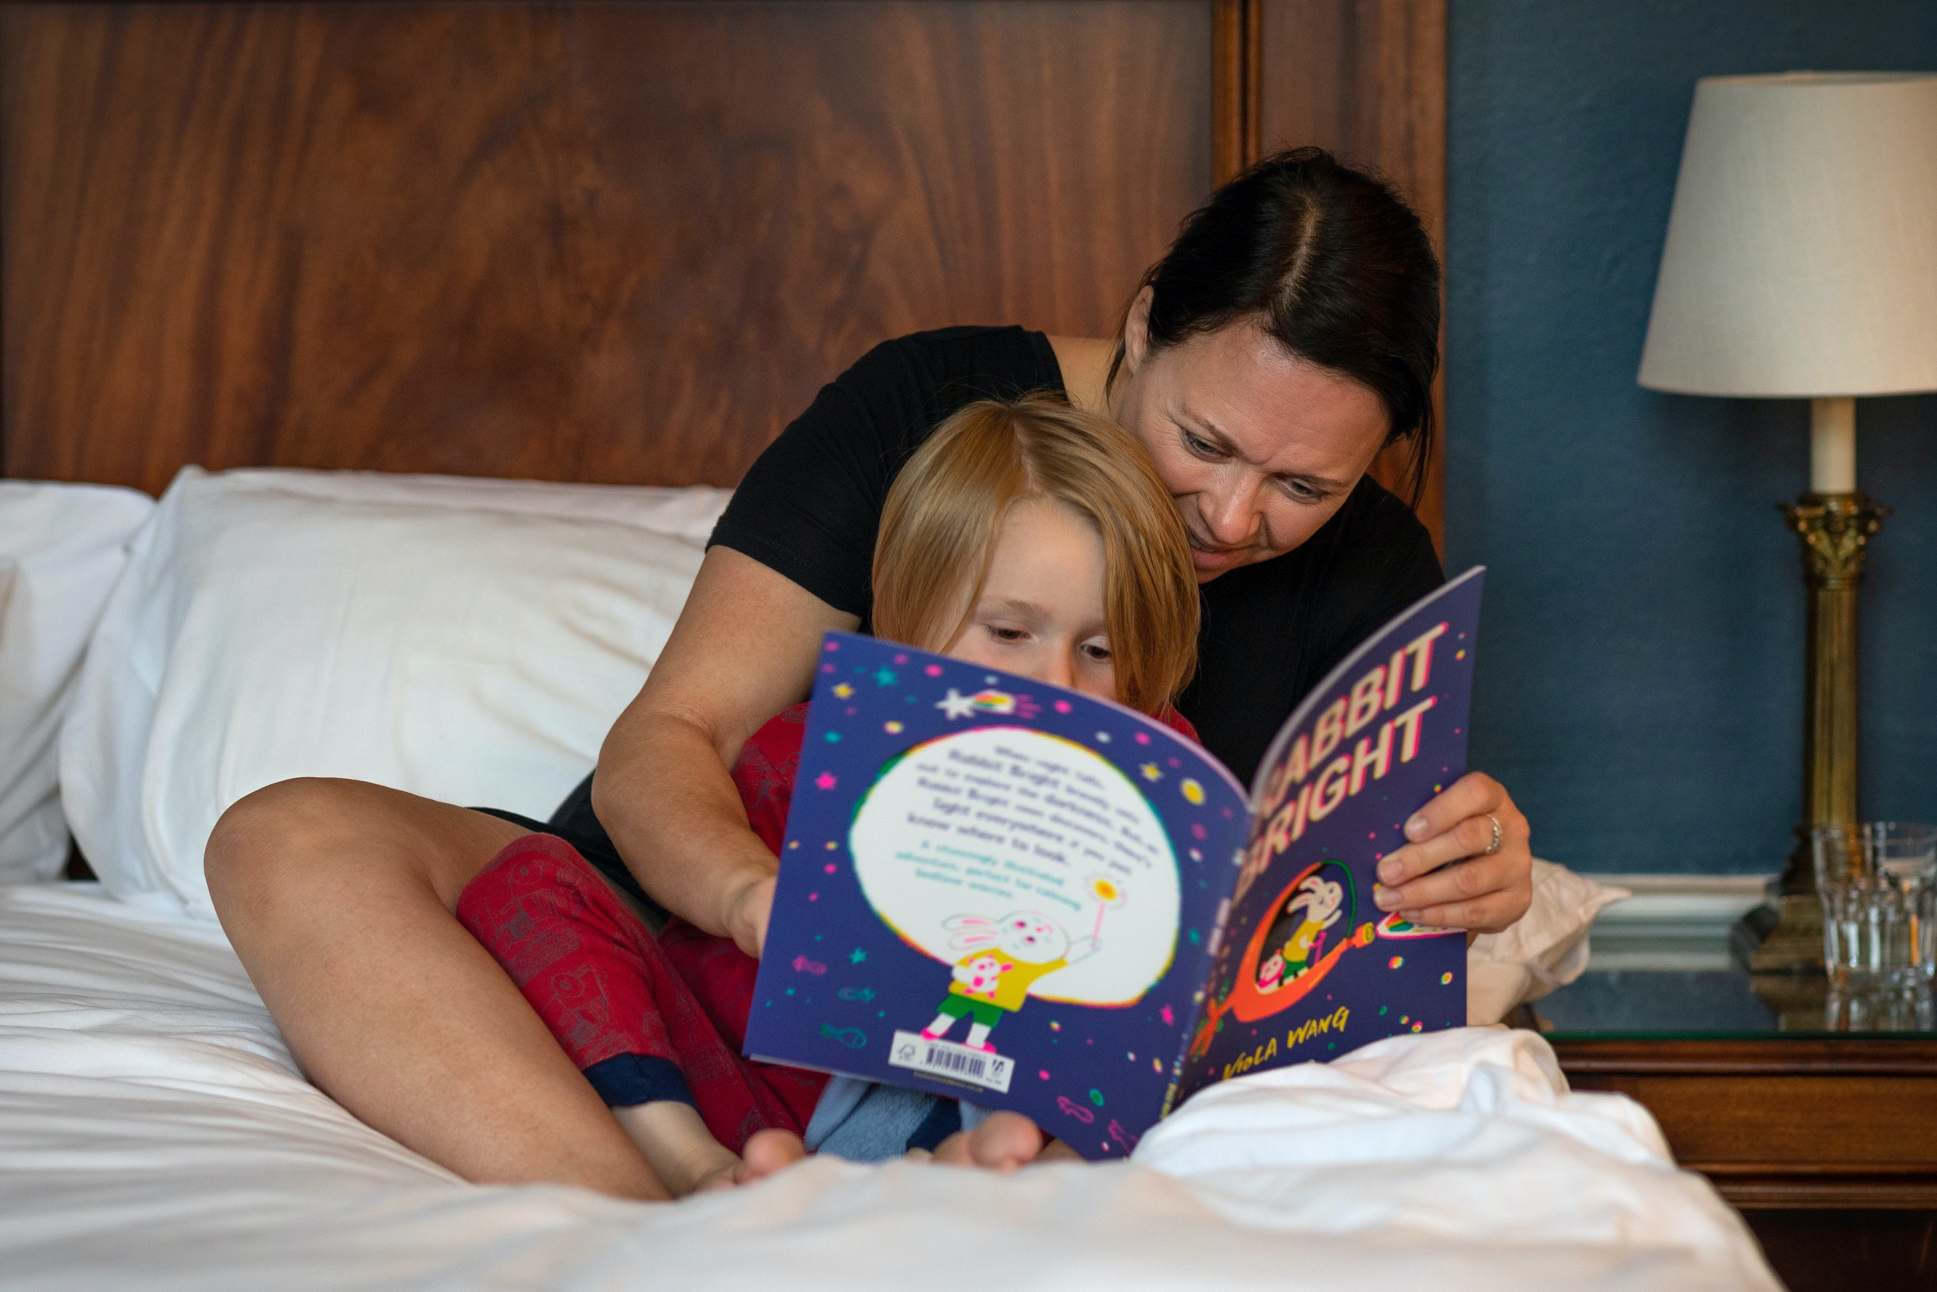
Why does reading together every day matter?
The number of books your child has encountered by the age of six is a
positive predictor of their reading
ability two years later.
This benefit comes from:
Adults reading to children and children enjoying books simply by looking at them and talking about them.
Parental involvement in the development of children’s reading skills: A five-year longitudinal study (2002) Senechal, M. and Lefvre, J.

Slide 11
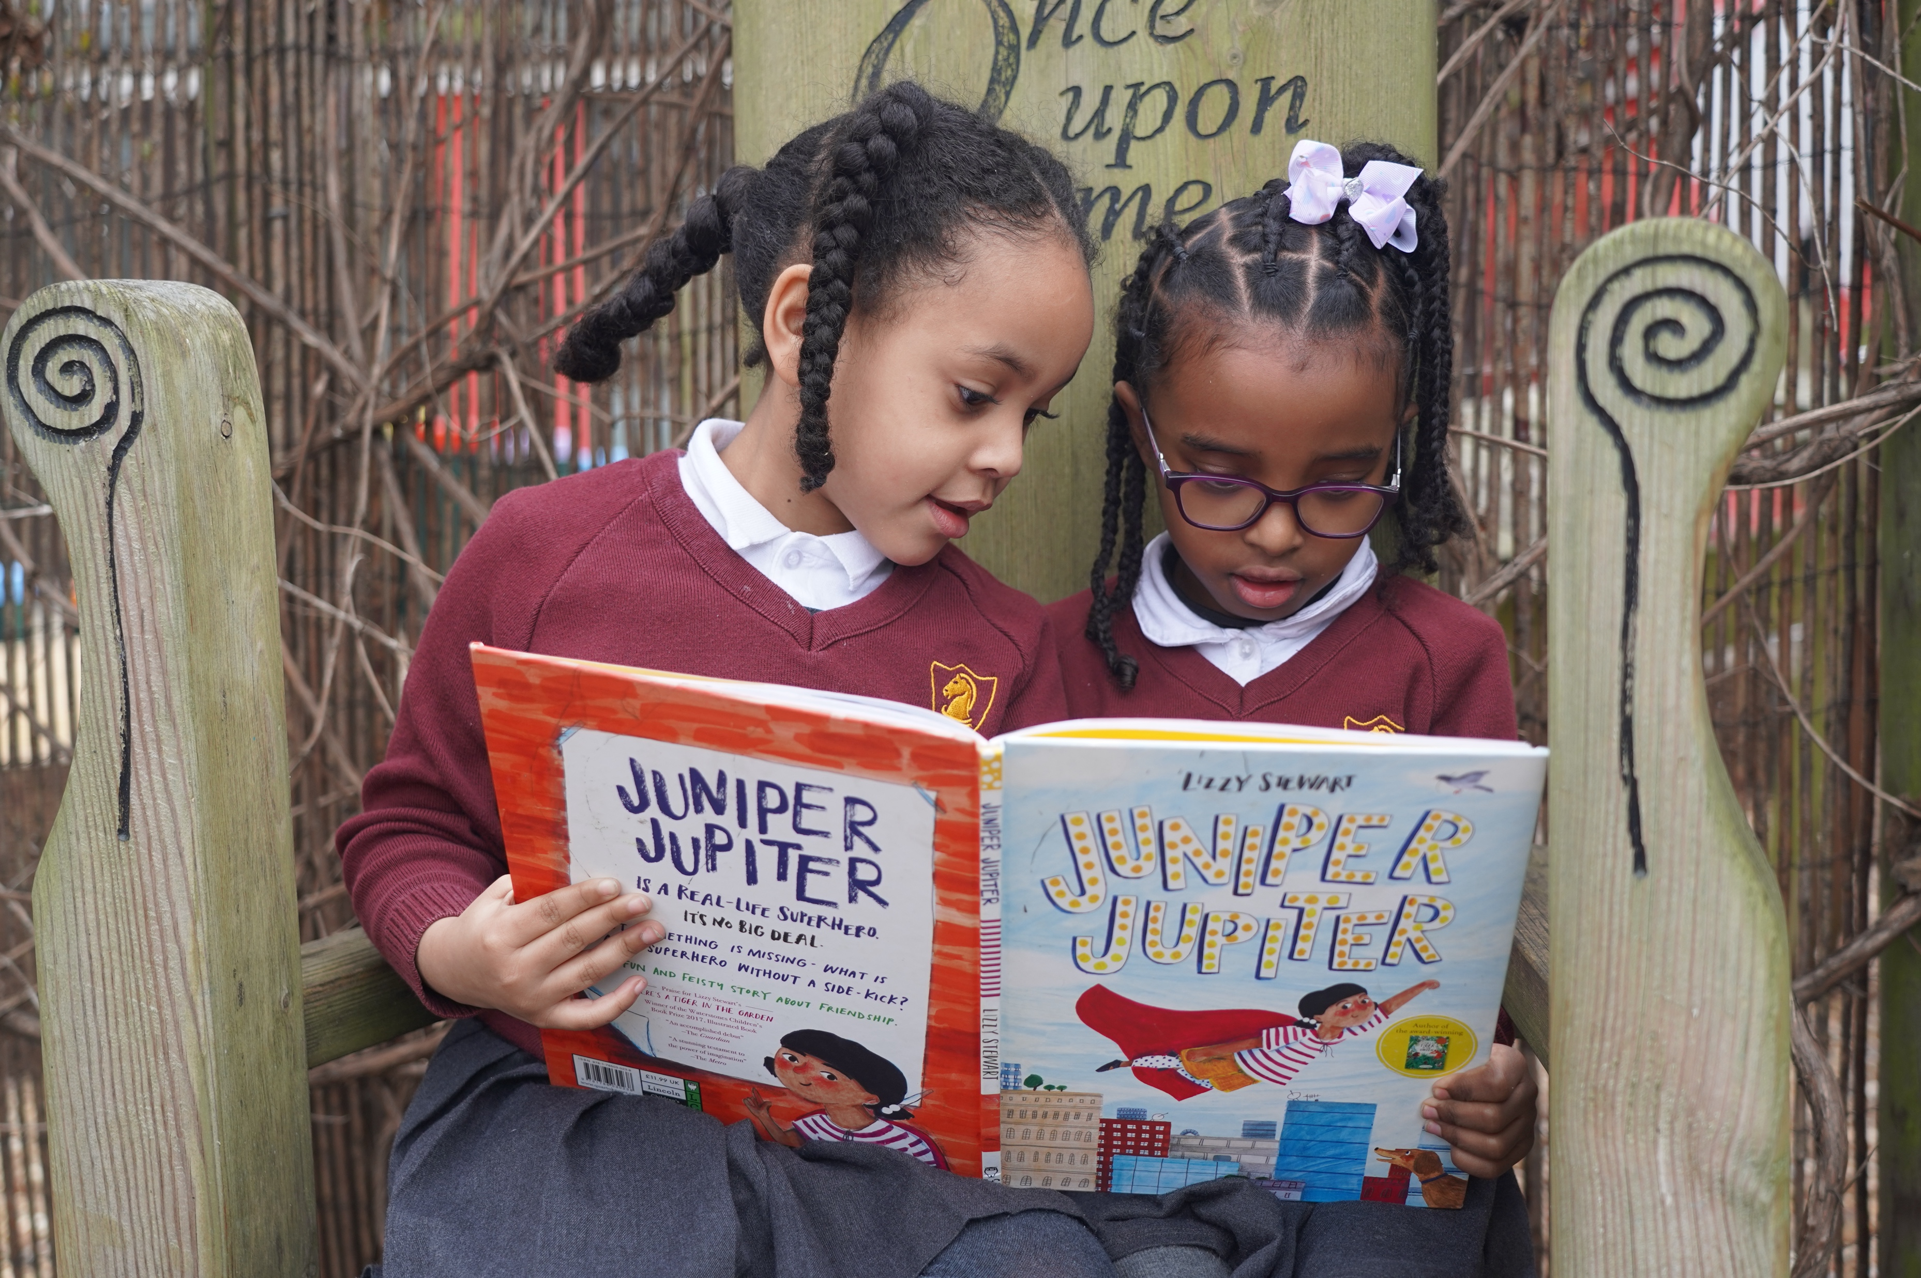
Does it matter how we read with our children?
Studies show that it’s the enjoyment and chat that matters!
The more you chat together about the book and things that interest your child, the more impact it has.
You don’t even have to read the words on the page – talking about the pictures is just as important.
If you can read the words, then use your voice to make them come alive. It will help your child understand the book even better.

Slide 12

Does it matter which language we use?
Use your home language.
It is better for your child to hear expert talk from you in your language.
Many studies tell us it is the back-and-forth talk between adults and children when they are sharing books that makes the difference to children’s language and comprehension.
This impact will translate to better language and comprehension for your child in English.

Slide 13
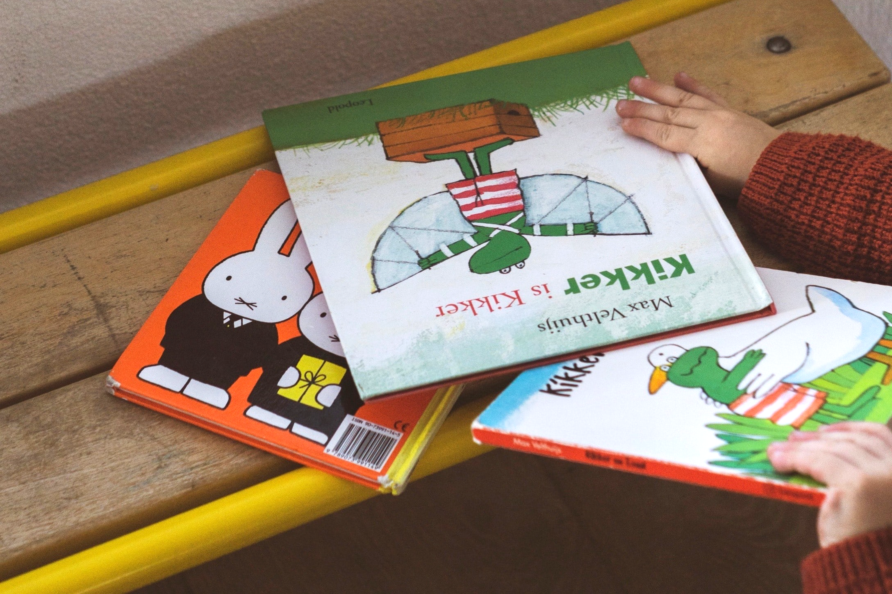
Does the type of book matter?
Let your child be the boss of the books they choose. Enjoyment really matters.
Comics, information books, magazines, story books, picture books, poems and leaflets are all great for sharing.
Catalogues are fun to share and talk about too.

Slide 14
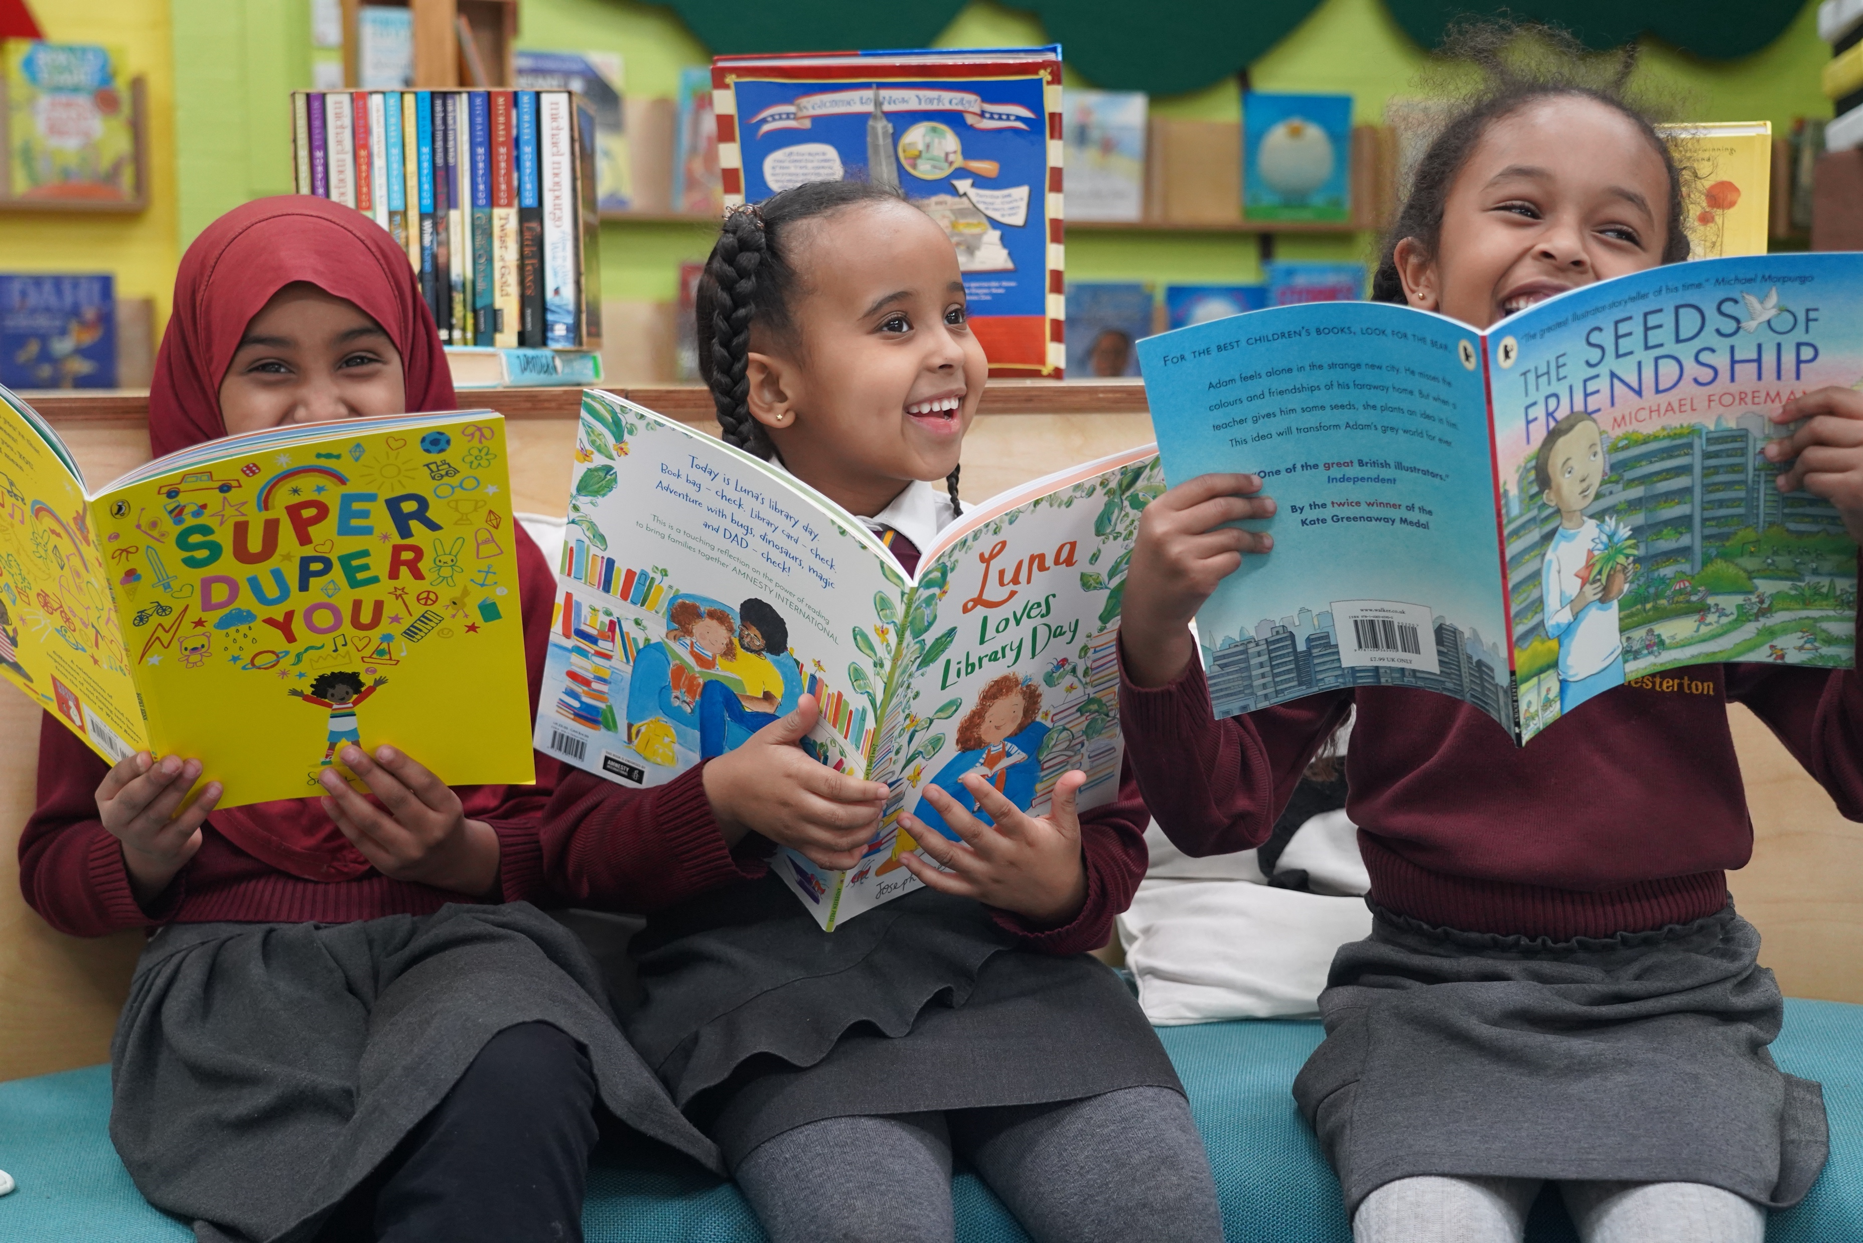
What if they always want to read the same book?
Repeated reading of books is really beneficial for children. It helps them memorise parts of stories, words and phrases too.
Knowing a book or poem by heart is fun and powerful for children, they can ‘read’ the story with you, or join in with words of phrases.
If you really want to mix it up, offer another book alongside the much-loved favourite!

Slide 15
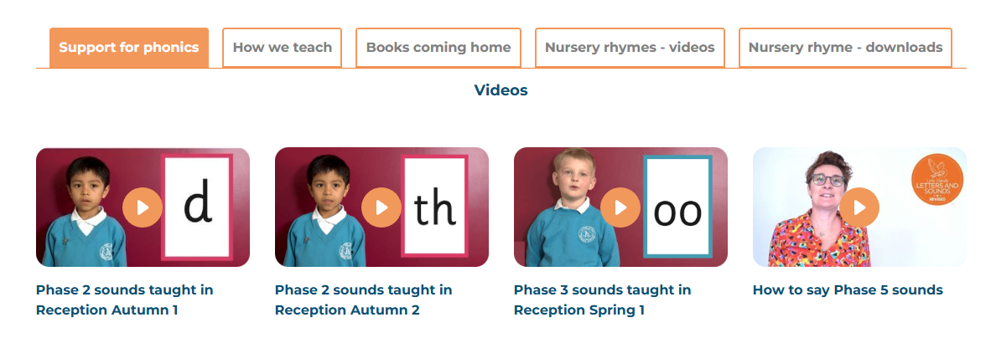
At home support
https://www.littlewandle.org.uk/resources/for-parents/

Slide 16
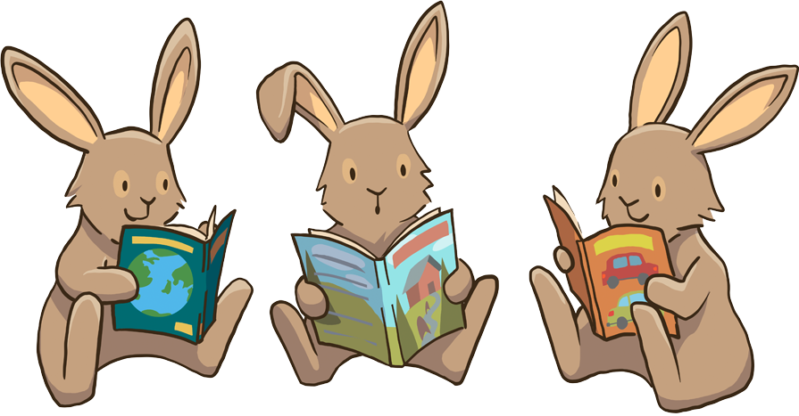
A love of reading is the biggest indicator of future academic success!

Slide 17
Please exit via the main playground as the intercom system at Sussex Street gate is being replaced.

